Slide 1


Automatic Deep Learning-based monitoring of security fences in drone orthophotos
Corso: Computer Vision and Deep Learning
Prof: Emanuele Frontoni
Tutor: Luca Romeo, Riccardo Rosati
Brugiavini Alessio
Romanelli Marco
18/07/2022

Slide 2
Introduction
Nowadays, during the safe demarcation of work areas, it’s necessary to recognize and monitor the yard’s perimeter due to safety pourpose. In this scenario, CNN’s Classification Network is the perfect choice in order to satisfy this request.We compute square patches representing the yard perimeter, these patches will form the training and validation dataset for a VGG16 CNN’s, which is perfect for object recognition and classification of fence presence in the yard field.

Slide 3
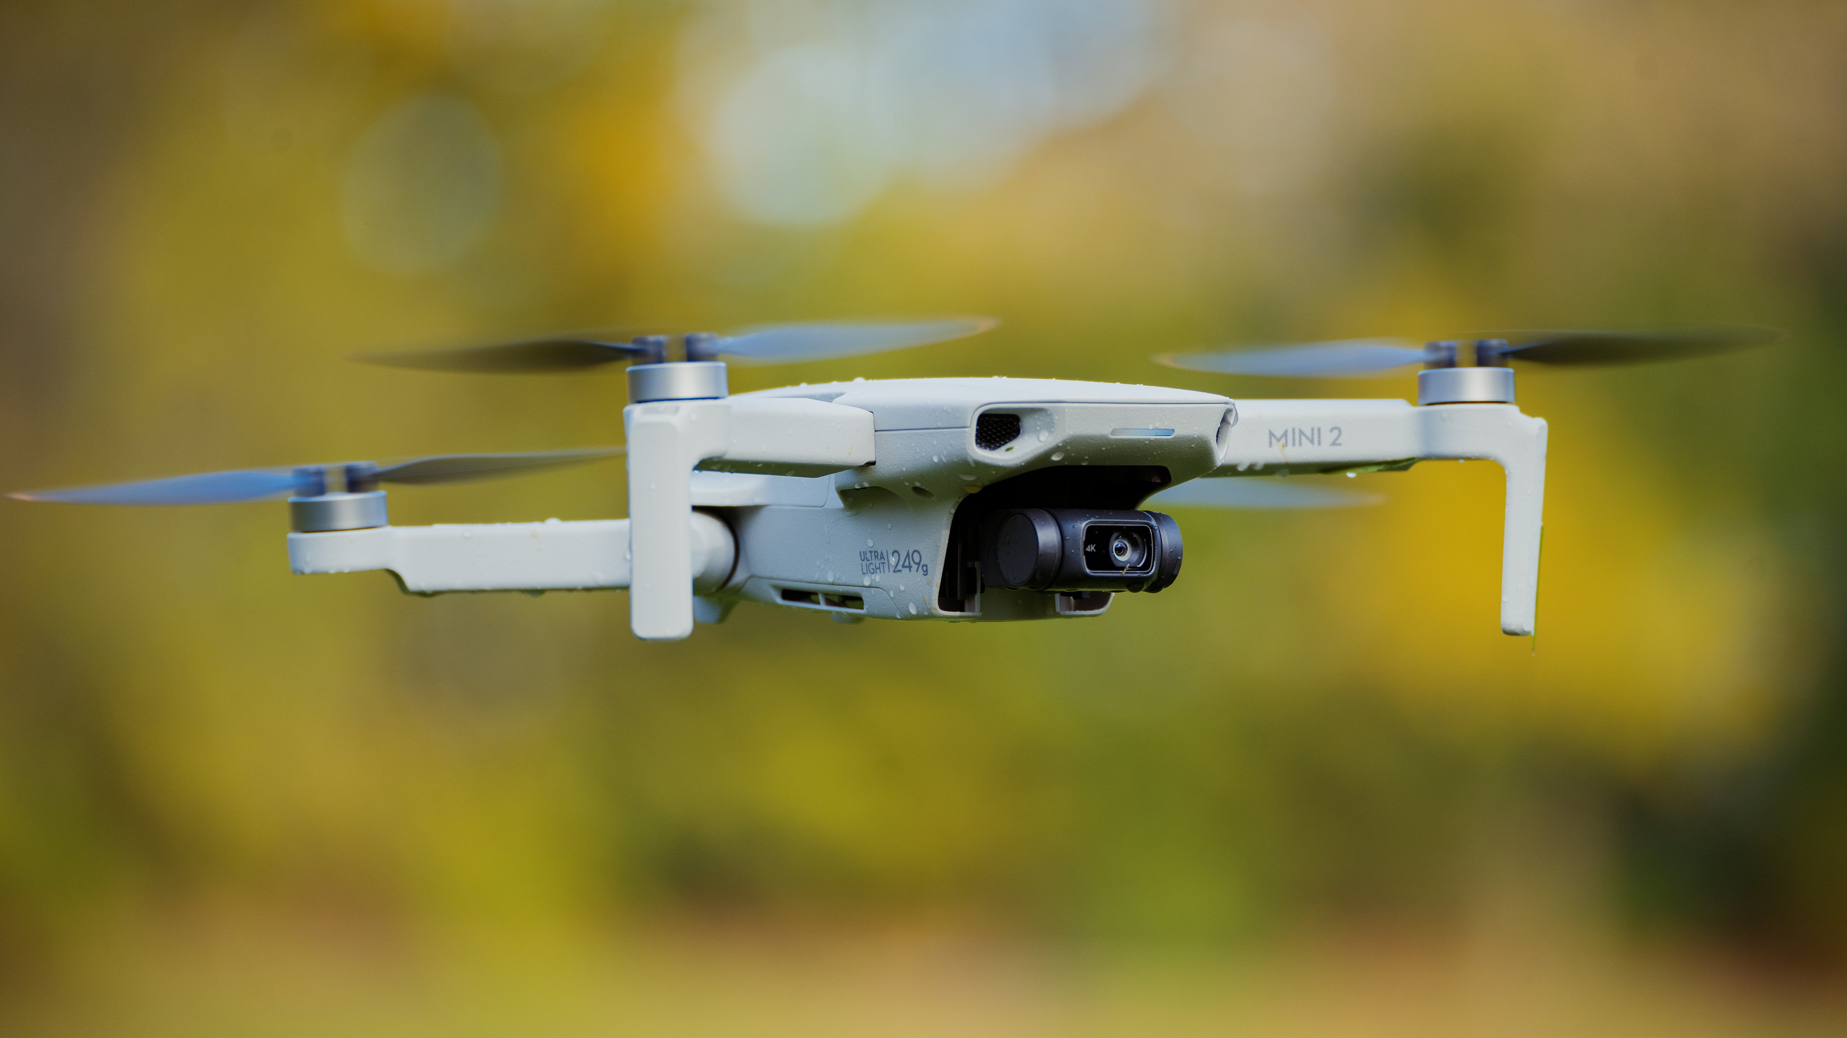
Drone DJ Mini 2
Image acquisition
This type of drone can be piloted wihout any documentation. The max covered distance is up to 6km. It's possible to set an automatic path.
OrtofotoRGB:
Extract by drone and save in geotiff.
It's a format supported by GDAL.
Format with georeferencing.

Slide 4
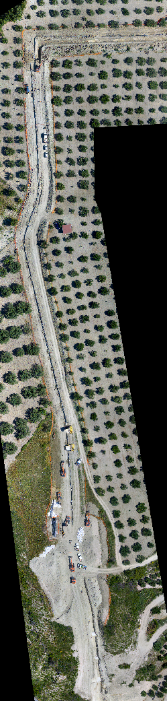
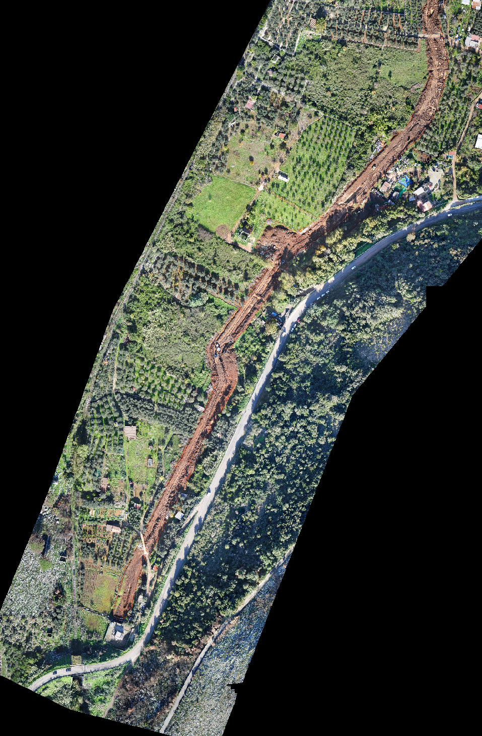
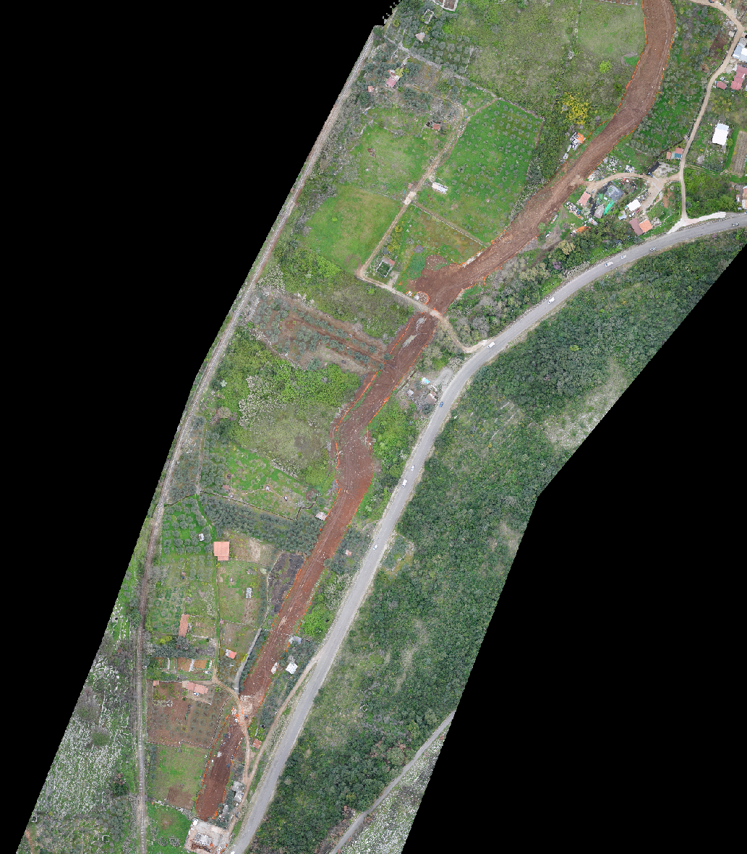
Ortophotos
Yard n 1:
Two images of two different drone fly. More than 1000 patch.
Yard n 2:
One drone fly.
400 patch.

Slide 5
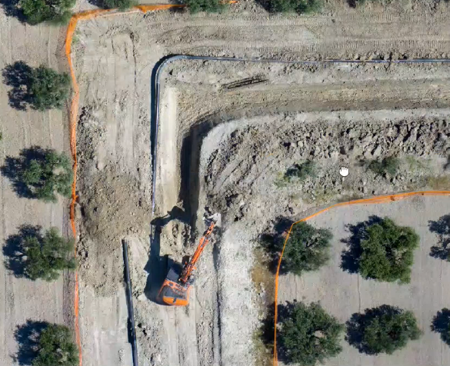
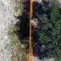
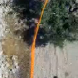
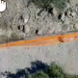
Preprocessing
1.GENERATING POLYLINE
2. TILES CREATION
3. TILES EXTRACTION

Slide 6
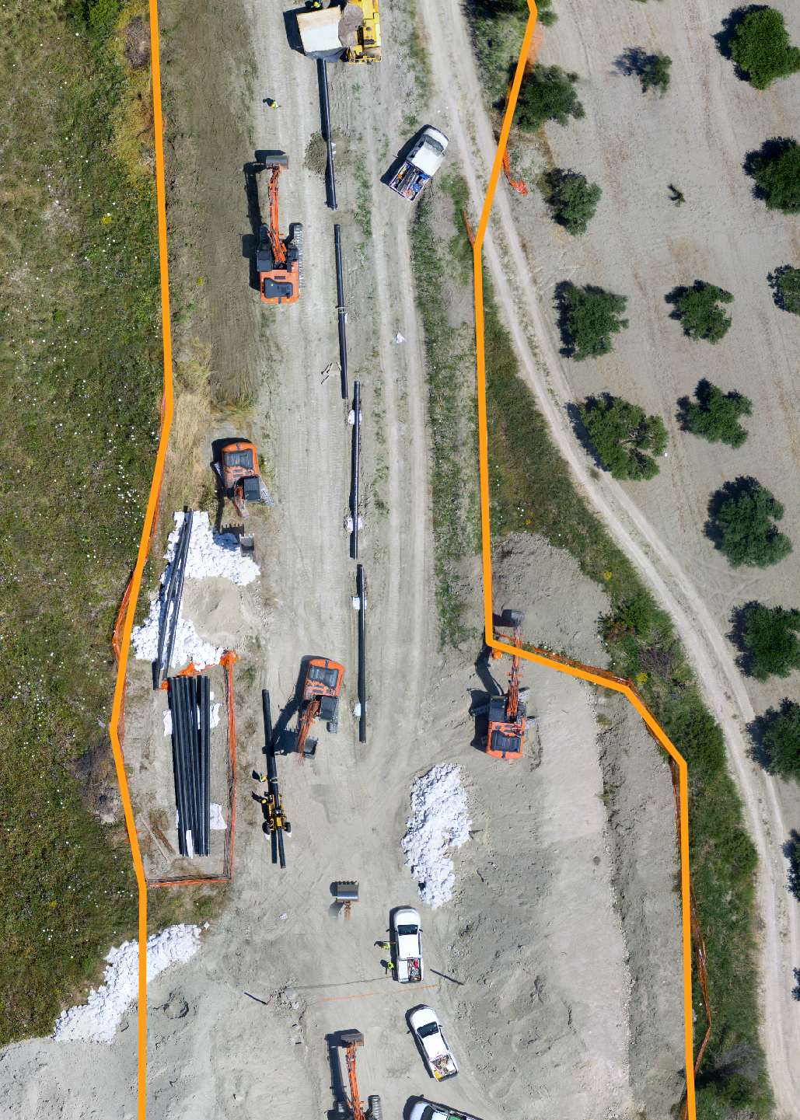
Polyline creation (QGIS)
QGIS is a desktop application GIS open source which allow to see, organize, analize and represent spatial data.
It's the most famous GIS software.
By QGIS it's been possible to create the polyline along the yard's edges where the fence it's installed

Slide 7
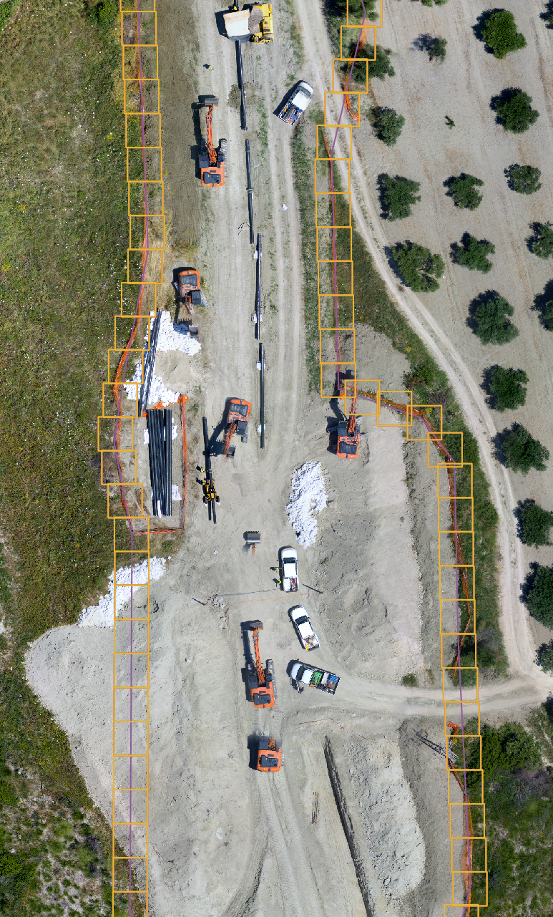
Tiles creation (GDAL)
Starting by shapefile, it was possible to implement a function for generate tiles.
GDAL: Geospatial Data Abstraction Library. The library allow to work with shapefile.
- Setable parameters. - Coordinates to pixel conversion.

Slide 8
Dataset
We have a total of 3 dataset, 1 for each drone flying.
Each dataset contain 2 sets of photos, with yard's fence (label 1), and without yard's fence (label 0).
Dataset 1: - 745 photos, 311 label 0 and 434 label1
Dataset 2: - 842 photos, 448 label 0 and 394 label 1
Dataset 3: - 333 photos, 81 label 0 and 252 label 1
First two dataset come from the same yard. Dataset 3, used for testing, is made of patches taken from another work area.

Slide 9
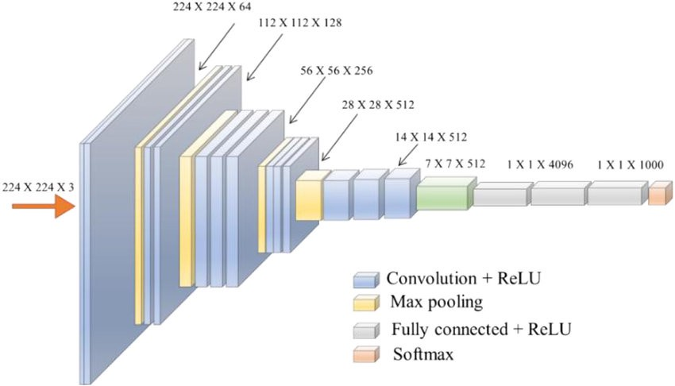
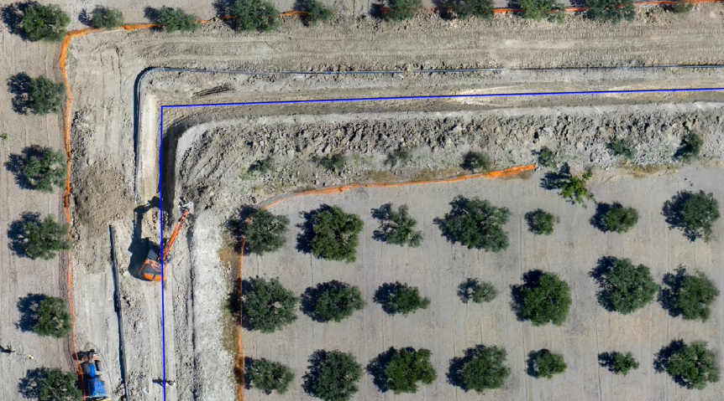
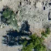
Classificaion model:
CLASSIFICATION LABEL
VGG16 PRE-TRAINED CNN
SHOWING RESULTS
Label 1
Label 0

Slide 10
Data augmentation
Data augmentation are techniques used to increase the amount of data by adding slightly modified copies of already existing data or newly created synthetic data from existing data. It Helps reduce overfitting.
Horizontal and vertical flip has been applied to the training set.

Slide 11
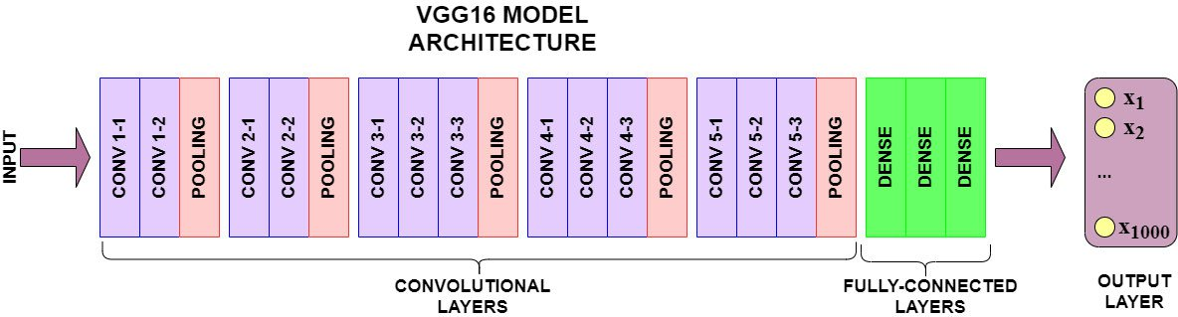
Fine-Tuning Pre-trained Model VGG-16
VGG16 is pre-trained convolutional neural network model.
It has 16 layers in total.
Convolutional layers using 3x3 size
Max pooling layers using 2x2
only the Fully Connected layers will be trained while keeping the feature extraction part of the model almost frozen

Slide 12
Best Hyperparameters
number of epochs = 30
Batc_size = 32
Learning rate = 0.0001
Momentum = 0.9
Early stopping: monitor ‘val_loss’, patience = 5

Slide 13
Experimental procedure
First test was performed with a 60-20-20 split combining dataset 1 and dataset 2, referring to the same yard, but with different weather conditions
For the second test we choose a 80-20 split. 80% for training and 20% for validation formed by dataset 1 and dataset 2 , and for test we used the dataset 3, which consist of patches taken from a new yard.

Slide 14
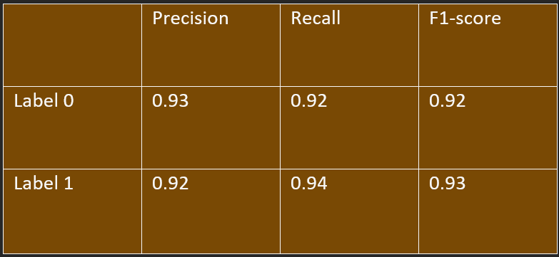
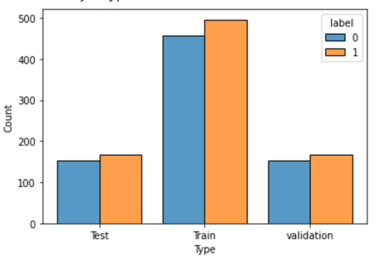
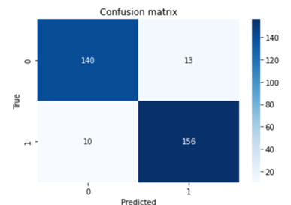
Test 1 : 60-20-20 split
Data Distribution :

Slide 15
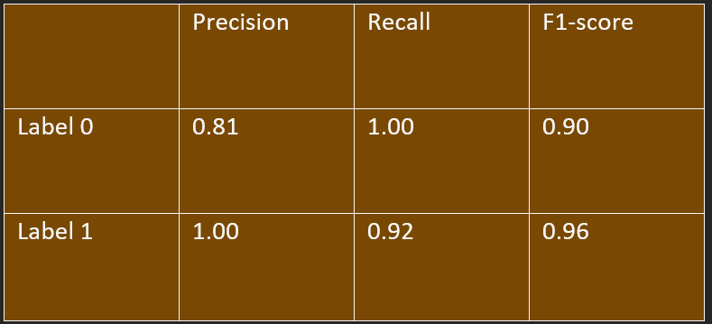
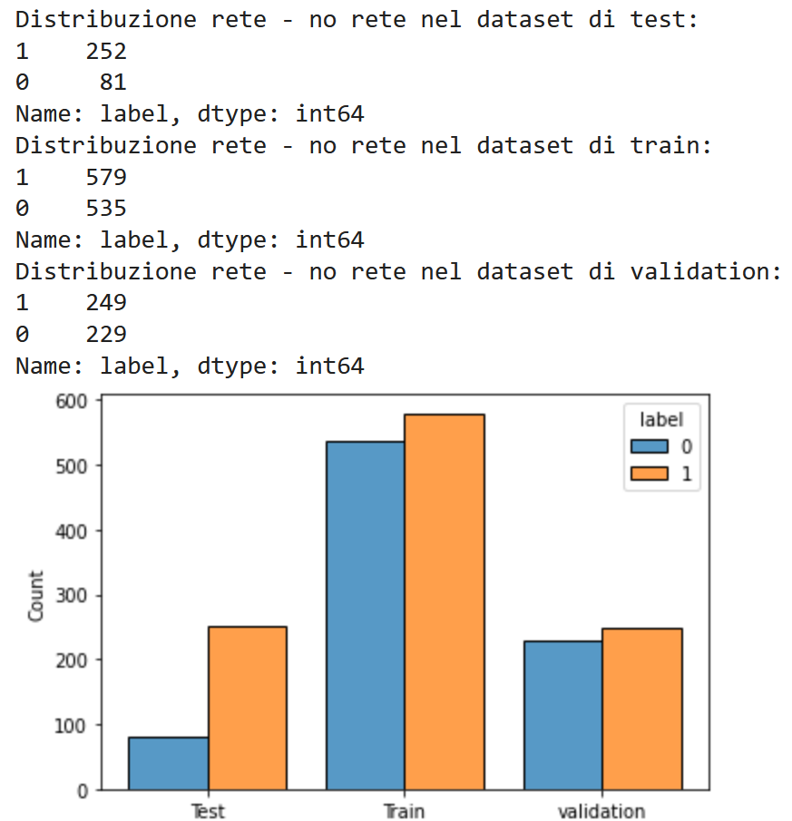
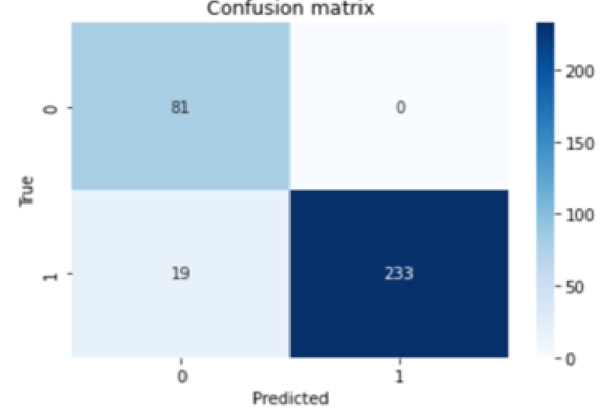
Test 2 : 80-20 split
Data Distribution :

Slide 16
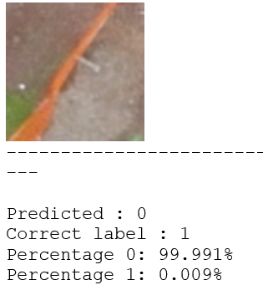
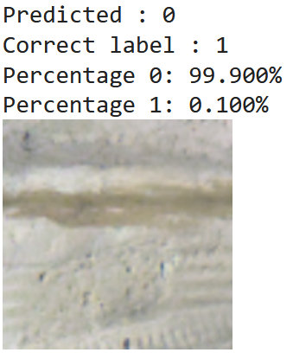
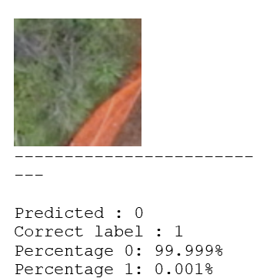
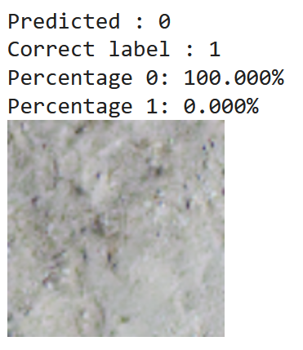
False positive patches and incorrect label

Slide 17
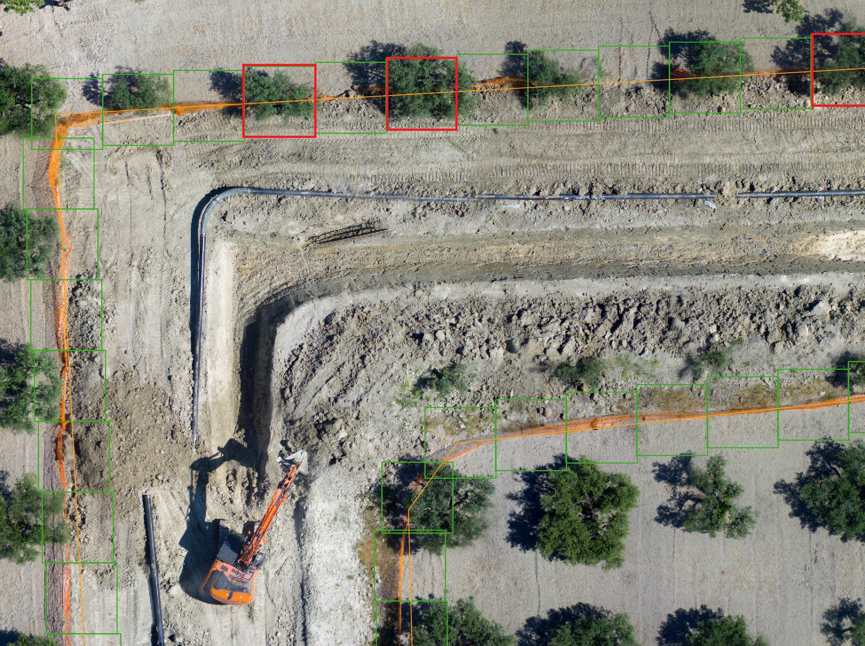
Data Visualization:

Slide 18
Discussions
The model works fine, it could be improved in order to decrease the number of false positive
It could be used for object recognition and classification of fence presence in the yard field, with less effort in term of time and cost.
Limits are related to different weather conditions and different yard’s terrain (intensity change),for example, the different type of field, could reduce the prediction accuracy.
The limits of this study are also related to the low number of drone fly done (3 only).
Incorrect label

Slide 19
Conclusion and future works
Decrease number of false positive
Taking more images of different yards, by doing more drone fly.
Take new test with a segmentation procedure.
Data set extension
Process industrialization.

